Slide 1
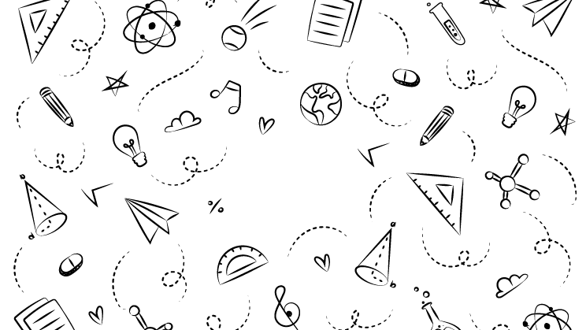



NEXT GEN EMPLOYABILITY PROGRAM
Creating a future-ready workforce
College Name
Student Name : Muhammed Thufayl Noor
Student ID : au311121205038
NM ID: 96746250A7448008B1F4C8556B6FDADA
LOYOLA – ICAM COLLEGE OF ENGINEERING AND TECHNOLOGY

Slide 2

CAPSTONE PROJECT SHOWCASE
Project Title
Music Web Application using Django Framework
Abstract | Problem Statement | Project Overview | Proposed Solution | Technology Used | Modelling & Results | Conclusion

Slide 3
Abstract
The "Music Web Application using Django Framework" project aims to create a comprehensive online platform for listening to and downloading music. Leveraging the Django web framework, the application provides users with a seamless and user-friendly experience for discovering, streaming, and downloading their favorite songs.
Source :

Slide 4
Problem Statement
In today’s Online world, there is no limit for entertainment. Music is a type of entertainment enjoyed by almost all. So to create an application which maintains a collection of music in all varieties for people to stream and download is needed.
Source :

Slide 5
Project Overview
The "Music Web Application using Django Framework" project aims to develop an online platform for music enthusiasts to discover, stream, and download their favorite songs. Using the Django web framework, the application will offer a user-friendly experience, providing access to a variety of genres, artists, and albums
Source :

Slide 6
Proposed Solution
.
To develop the "Music Web Application using Django Framework," we will utilize:
Vast variety of Music choice
User authentication
Stream and Download music
Search feature to discover songs
Source :

Slide 7


Technology Used
Front-end
Back-end
Source :

Slide 8
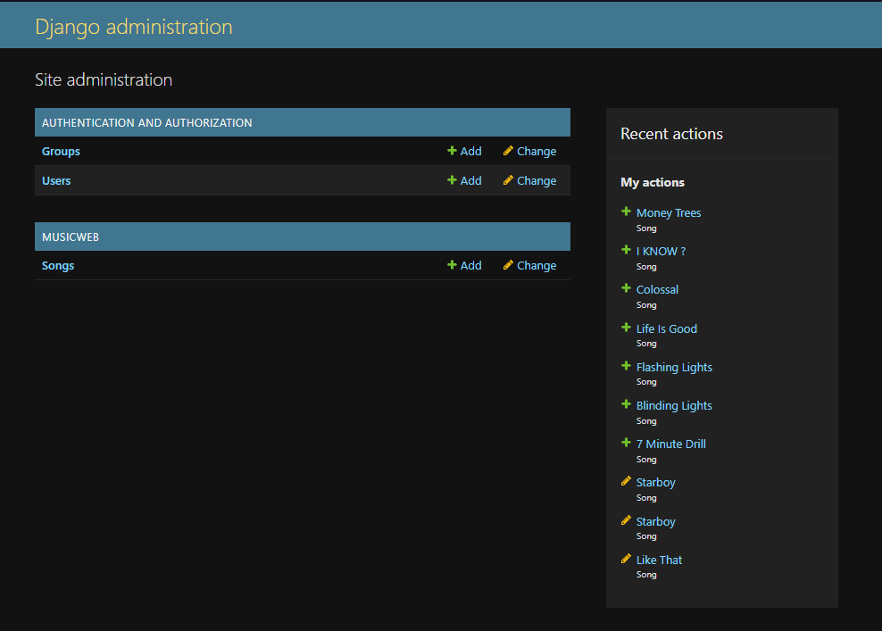
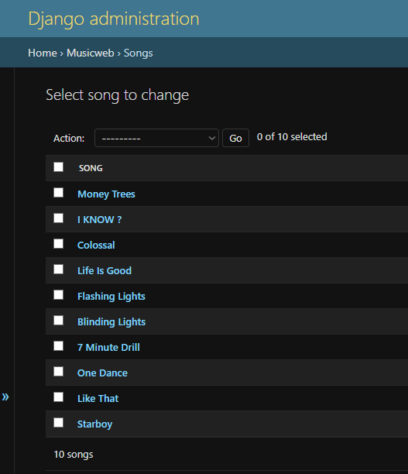
Modelling & Results
Source :

Slide 9
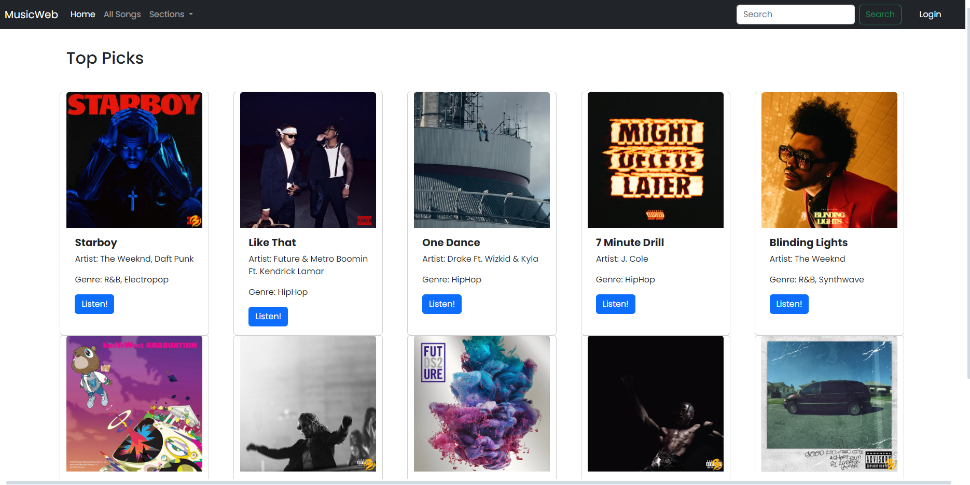
Homepage

Slide 10
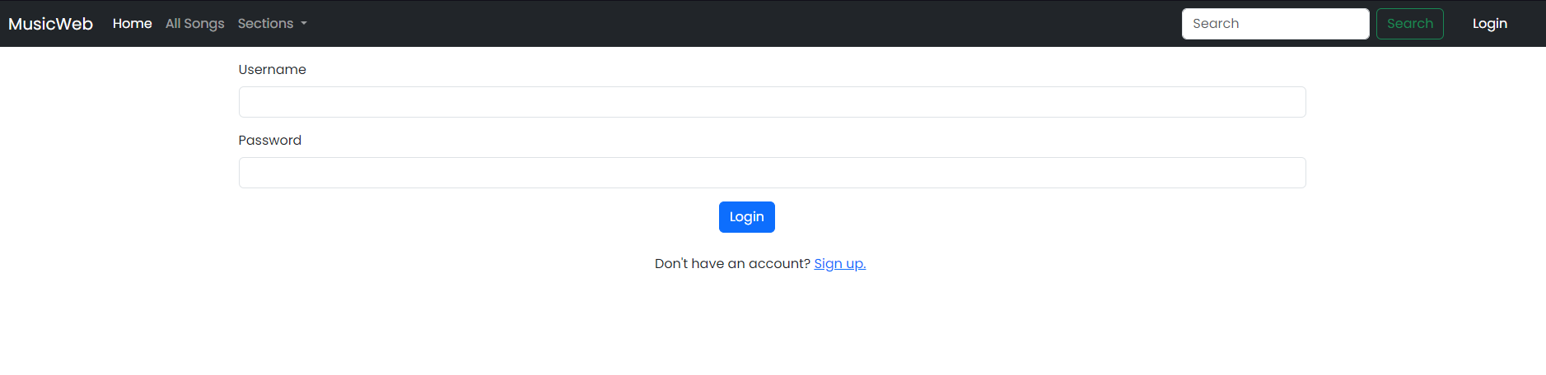
Login Page

Slide 11
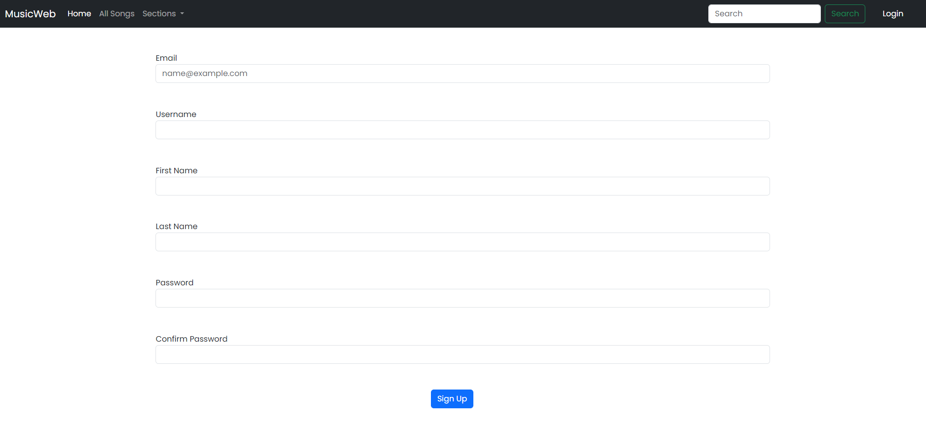
Signup Page

Slide 12
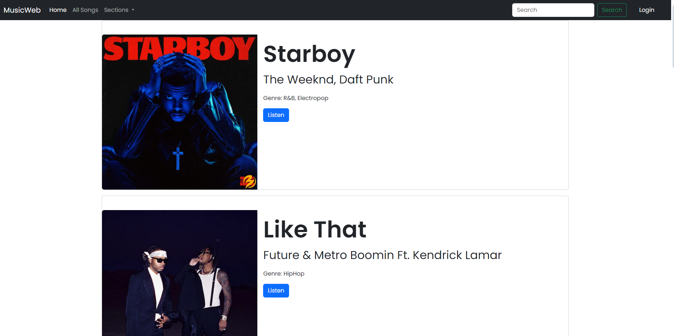
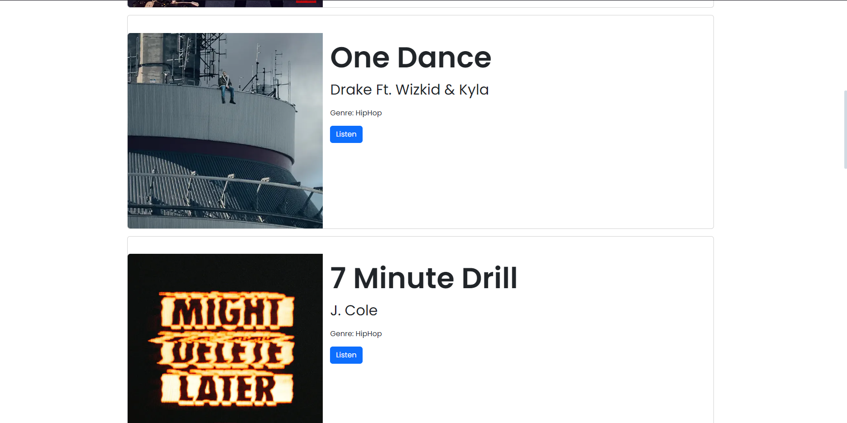
All songs Page

Slide 13
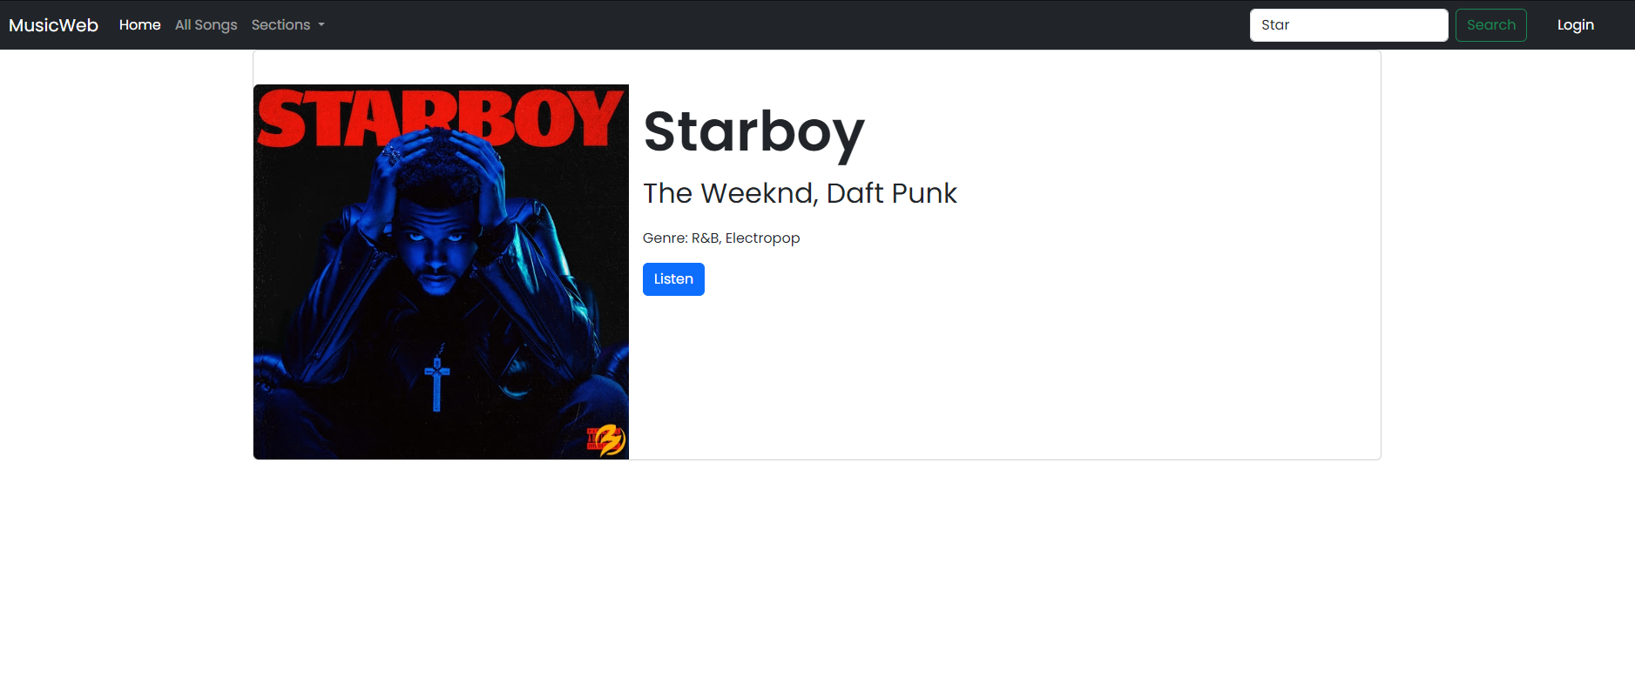
Search Feature

Slide 14
Future Enhancements:
Future enhancements for the "Music Web Application using Django Framework" project can include adding new features, improving existing functionalities, and expanding the platform's capabilities like:
Adding Accounts and let users connect with others
Add channels to publish their own music
Add features like Follow, like, etc…

Slide 15
Conclusion
In conclusion, the "Music Web Application using Django Framework" project was created to provide a user-friendly platform for music enthusiasts to discover, stream, and download their favorite songs. This web application allows you to be entertained without any hindrances.
Source :

Slide 16
Thank You!
Notes:
Thank You !!

